Slide 1
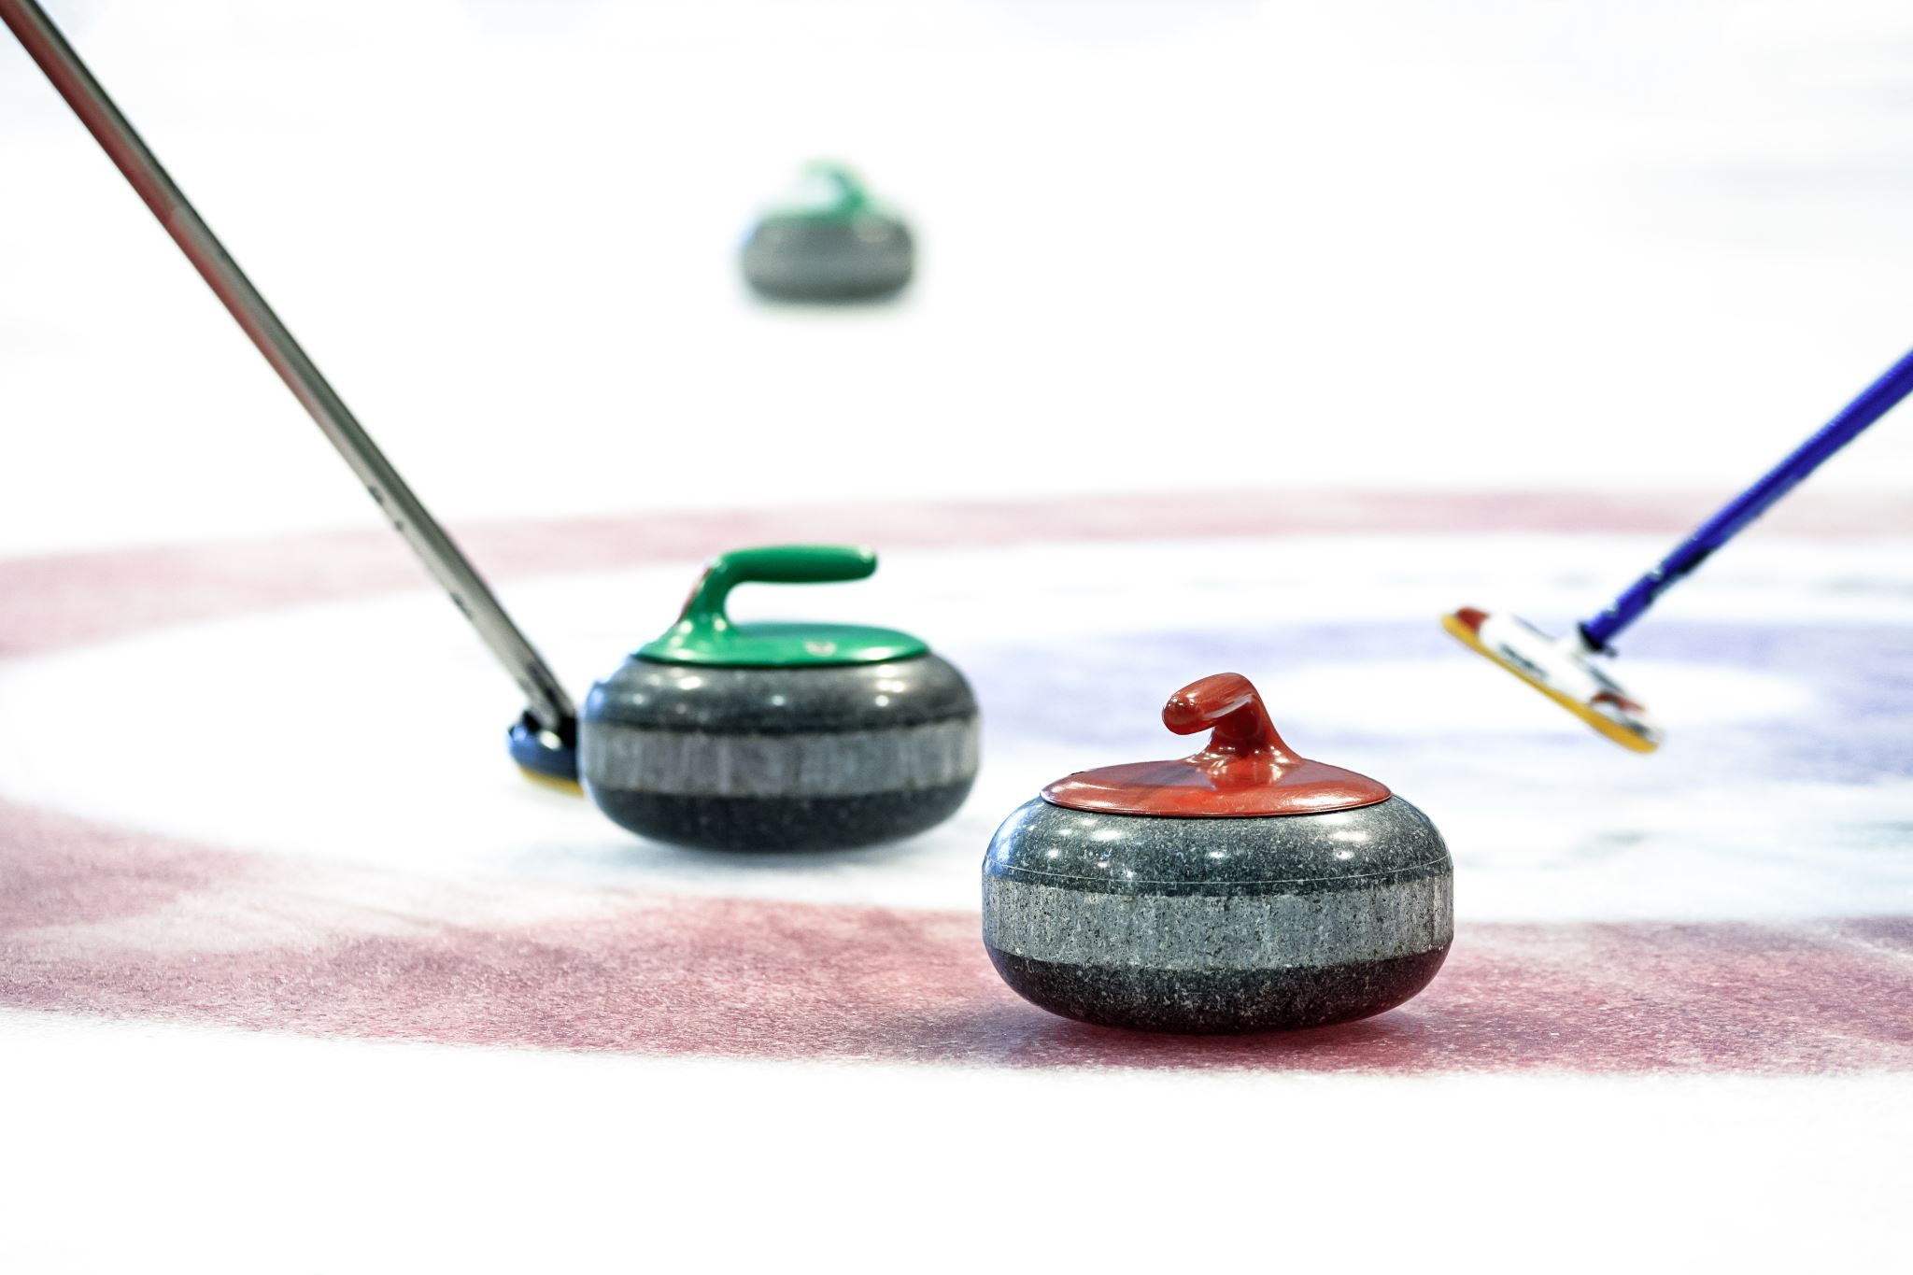


Benefits of Stick Curling

Slide 2
What is the Stick Curling Game?
2 person teams
6 ends
Takes one hour to play the game
Limited sweeping- only from hog line in
Different strategy-can only remove rocks in play on the 4th rock
Can join and participate in leagues

Slide 3
Who Can Play?
Anyone
Juniors up to ninety plus
Excellent for people with mobility or joint issues
Easiest entry point to curling for non-traditional players

Slide 4
Benefits for Curlers
Allows traditional curlers to prolong their career twenty plus years
Facilitates a return to curling for retired players
Makes it easy to take up curling later in life
Social interaction and physical activity benefits
Be part of a remarkable and inclusive sport

Slide 5
Benefits for Curlers
Skill development of non-skips to read ice
Increased understanding of strategy
  different than 8 end 4-person game
Shorter game
  Normally one hour

Slide 6
Benefits for Curlers
To be a part of the stick curling community
  Friendly & social group
To join one of the fastest growing sports in Canada
To participate in local / provincial competitive leagues, NS Stick Curling Association (NSSCA) provincial championships, the Maritime stick curling championship and Canadian stick curling championship

Slide 7
Benefits to Clubs
Retention of traditional curlers and increased revenue from stick curling leagues
Additional volunteers to assist with other events in club
Increased demographics of members.
Stick curling is age, gender and ability neutral.
Increased equipment sales
Increased bar and food sales
Opportunity to host stick curling bonspiels at your club

Slide 8
Benefits to Clubs
Seniors want to be active as long as possible.
Canadian Seniors programs have grants and funding initiatives to support this endeavor

Slide 9
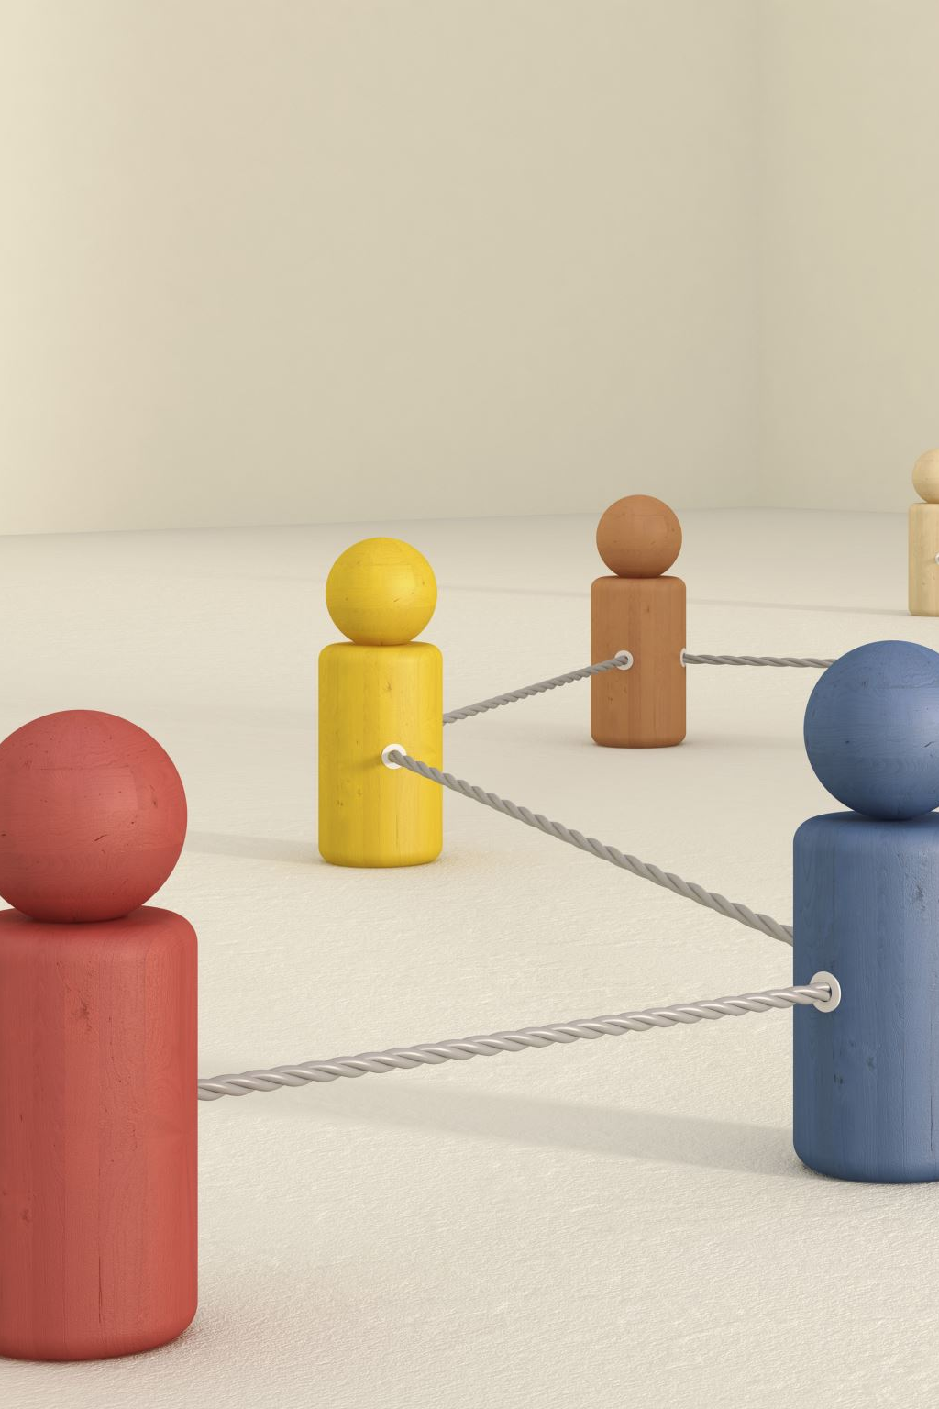
Community & Social Benefits
Social interaction with other curlers – no age restrictions
Provides an opportunity for club members to try a different curling format.
No sweeping between hog lines is safer for older members
Promotes the health of inactive seniors

Slide 10
Summary
The Stick Curling game is supported provincially by NSSCA & nationally by the Canadian Stick Curling Association (CSCA)
Offering Stick curling game at your club promotes inclusiveness & longevity in the sport
It is our belief that all curlers (new & existing) should learn how to deliver a rock using a delivery stick.
Most will need to use a delivery stick to continue to play the traditional curling game.
Learning to curl with a delivery stick will facilitate recruitment and retention of new curlers (especially non-traditional curlers)

Slide 11
CONTACT YOUR LOCAL CURLING CLUB TO BE PART OF THE FASTEST GROWING SEGMENT OF CURLING
YOU WILL LOVE IT!

